Slide 1
Agenda
Overview
Review
Roles
Lists
Libraries
Columns
Views
Pages
Web Parts
Navigation
Office
Wrap-Up

Slide 2
About Columns
Each file in a library and item in a list has properties
For example, a Word document can have an author, modified date, and creation date and an announcement can have a title, body and expiration date
Those properties (metadata) are stored in SharePoint columns

Slide 3
About Columns
Some columns are automatically created when a list or library is created
A column is stored in the list or library where it’s created – and is only available for use in that list or library
Before you create a new column, see if it already exists
Site columns are a bit different – details later

Slide 4
Let’s Learn How to…
Create a column

Slide 5
Create a Column
LIST or LIBRARY tab > List or Library Settings > Create Column
Define name, type of information and additional settings > OK
OR
LIST or LIBRARY tab > Create Column
Define name, type of information and additional settings > OK
The first approach is better:
You see a list of all columns, their type and their required status
You see the options at the bottom of the list
You can add the column to the default view

Slide 6
Common Column Settings
Most, but not all, columns have these settings
Description – An explanation of the item or file
Require that this column contains information – Column must contain data; indicated by an asterisk (*)
Enforce unique values – Column cannot contain duplicate values
Column Validation – Column data meets certain criteria

Slide 7
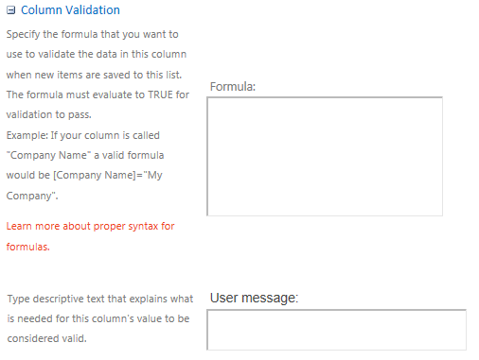
Column Validation

Slide 8
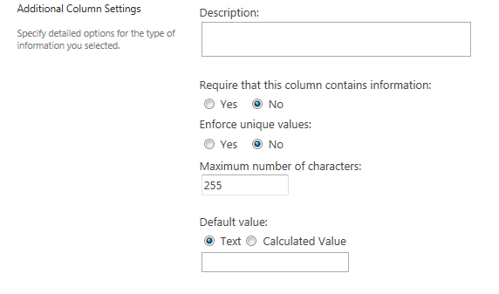
Single Line of Text
This column contains one line of text
This column is best for short, variable information such as a last name
You can limit the number of characters

Slide 9
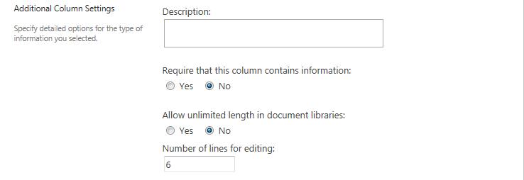
Multiple Lines of Text
This column contains as many lines of text as needed; a scroll bar appears if necessary
This column is best for longer, variable information such as comments
You can limit the number of lines for the text box, but this does not limit the amount of text entered
You can add pictures, tables, text formatting, hyperlinks, etc.

Slide 10
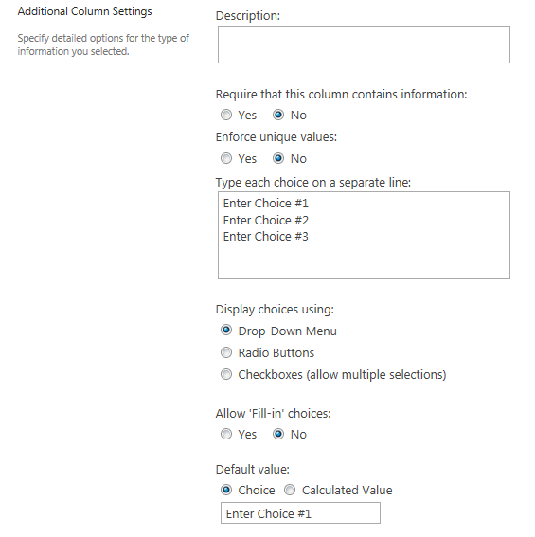
Choice
This column lets a user choose values
Use radio buttons for 1-3 choices to minimize clicks
Use a drop-down for 4 or more choices to save space
Use checkboxes for multiple selections – but multiple selections may disrupt other features

Slide 11
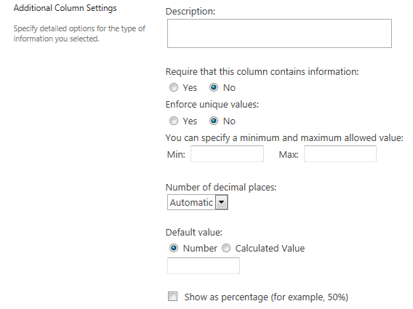
Number
This column contains numeric values
Do not use this column type for phone numbers or dates/times
You can enter a default number (or calculated value) to use

Slide 12
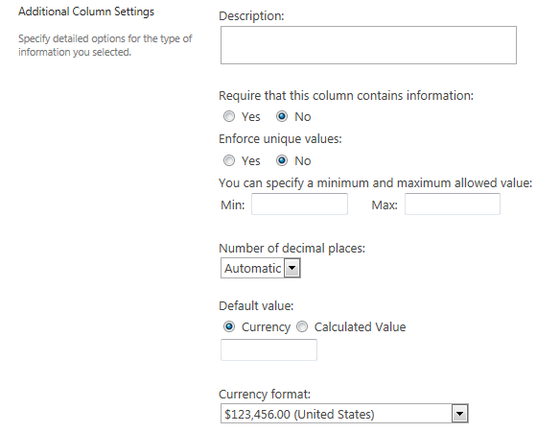
Currency
This column contains currency values
You can enter a default number (or calculated value) to use
You can choose a currency format from a drop-down

Slide 13
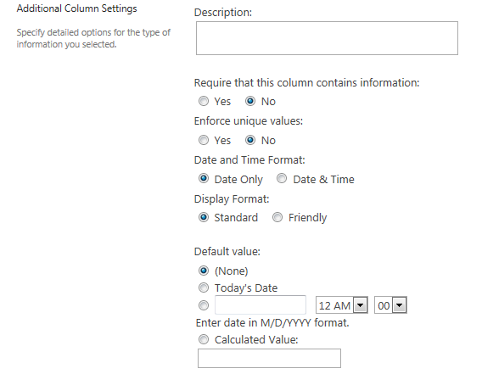
Date and Time
Use this column type for dates and times
Otherwise, calendars and other features that require a date/time format won’t work
The Friendly display format is like Facebook – it tells you how long ago an event happened (such as 6 hours ago) rather than giving a date

Slide 14
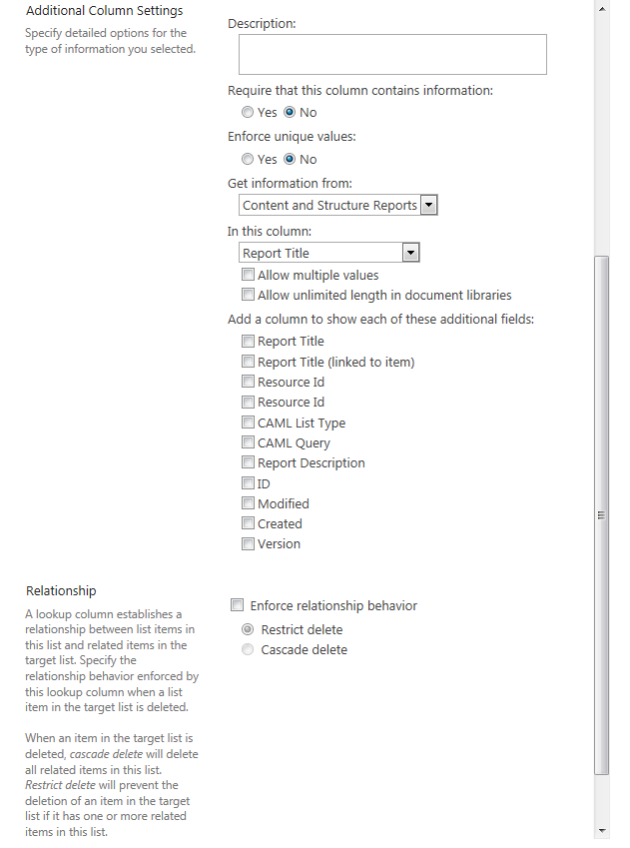
Lookup
The lookup is a drop-down or checkboxes and is populated with values from a column in another list
If you delete an item in a lookup
Cascade Delete deletes the item in all other lists
Restrict Delete warns that the item is used as a lookup
You can display more columns from the other list. For example, if District is used in the Lookup column, you can also display Division if it is in the same list as District.

Slide 15
Lookup
Lookup columns are extremely efficient
If you need to add a new vendor, it is much faster to update the lookup column once than to add a new vendor wherever the list of vendors appears

Slide 16
Yes/No – Settings
This column adds a checkbox
Checked means Yes and unchecked means No

Slide 17
Person or Group
This column searches the Active Directory (AD) system and matches the member or group you enter
Because SharePoint can access information in a person’s AD account, the Show Field drop-down lets you choose which AD information to display in the column

Slide 18
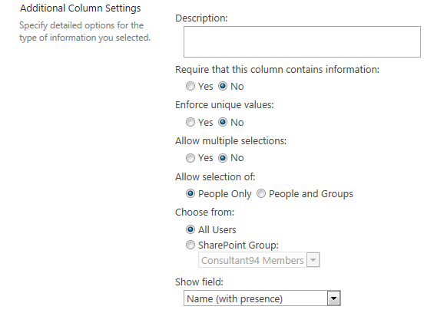
Person or Group – Settings

Slide 19
Hyperlink or Picture – Settings
This column contains a hyperlink
Choose whether to display it as a hyperlink or a picture. You might prefer a picture if you have a link to the image.

Slide 20
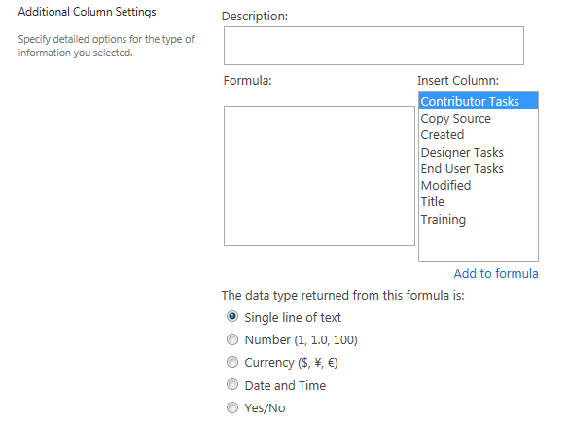
Calculated Column
This column contains a formula that calculates a value
For example, if one column has the day’s high temperature and another has the day’s low, enter a formula to derive the average
There are many similarities with Excel formulas

Slide 21
Sample Date Formulas
Calculate difference in days between two dates | =DATEDIF([Start Date],[End Date],”d”)
Calculate difference in months between two dates | =DATEDIF([Start Date],[End Date],”ym”
Extract the year from a date in End Date column | =TEXT([End Date], “YYYY”)
Convert month from name to number | =MONTH(DATEVALUE([Name of Month]&" 1"))

Slide 22
Sample Math and Text Formulas
Tax calculation | =[Cost]*[Tax Rate]
Calculate an average | =AVERAGE([District 2 Permits - January],[District 2 Permits - February])
Combine first name and last name | =[FirstName Column]&” “&[LastName Column]
Caps Lock your text (ex: apple) | =UPPER([ColumnA]) = APPLE

Slide 23
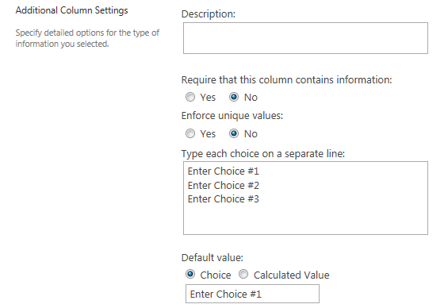
Task Outcome – Settings
Use this column to create custom text for the buttons on a task

Slide 24
External Data
This column links to a data source outside of SharePoint (such as a list of products in SAP)
Call or email the Help Desk to request assistance from Web Services

Slide 25
Managed Metadata
This column uses data stored in the SharePoint Term Store
You can use data from different site collections
The autocomplete feature suggests options that match what you are entering
Call or email the Help Desk to request assistance from Web Services

Slide 26
Let’s Learn How to…
Configure this type of column
Single line of text
Multiple line of text
Choice
Number
Date and Time
Calculated Column
Remove a column
Reorder the columns
Configure a default value for a library column
Add a validation check

Slide 27
Create a Single Line of Text Column
LIST or LIBRARY tab > List or Library Settings > Create Column
Name the column > Single line of text
Complete additional settings > OK

Slide 28
Create a Multiple Line of Text Column
LIST or LIBRARY tab > List or Library Settings > Create Column
Name the column > Multiple lines of text
Complete additional settings > OK
NOTES
Number of lines for editing does not restrict the amount of text the user can enter; it defines the size of the text box for data entry
Append Changes to Existing Text is only available if versioning is turned on

Slide 29
Create a Choice Column
LIST or LIBRARY tab > List or Library Settings > Create Column
Name the column > Choice (menu to choose from)
In Type each choice on a separate line, enter the choices
Define how to display the choices
Complete additional settings > OK

Slide 30
Create a Number Column
LIST or LIBRARY tab > List or Library Settings > Create Column
Name the column > Number (1, 1.0, 100)
Complete additional settings > OK

Slide 31
Create a Date and Time Column
LIST or LIBRARY tab > List or Library Settings > Create Column
Name the column > Date and Time
Complete additional settings > OK

Slide 32
Create a Calculated Column
LIST or LIBRARY tab > List or Library Settings > Create Column
Name the column > Calculated (calculation based on other columns)
Define the formula by selecting other columns from Insert Column > Add to formula
Define data type created by the formula
Complete additional settings > OK

Slide 33
Example: Difference in Dates
Calculate difference in two dates

Slide 34
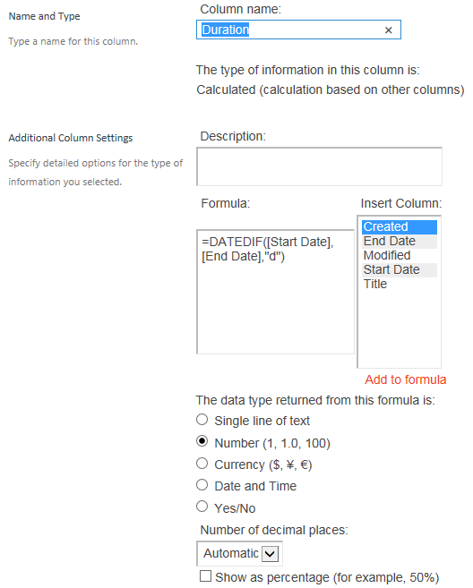
Example: Difference in Dates
Duration Column is a Number column with this formula: =DATEDIF([Start Date],[End Date],"d")

Slide 35
Example: Calculate Region
Have the user select the Division and the Region is calculated
Division is a site column
Create Region is a calculated column

Slide 36
Example: Calculate Region
The formula is spaced for clarity; do not use spacing when entering into formula text box
=IF(OR(Division="01",Division="02", Division="03",Division="04", Division="06"),"Eastern", IF(OR(Division="05",Division="07", Division="08",Division="09"), "Central", IF(OR(Division="10",Division="11", Division="12",Division="13", Division="14"),"Western"," ")))

Slide 37
Remove a Column
LIST or LIBRARY tab > List or Library Settings
Select column name > Delete > OK
This removes the column from the list or library, but does not delete the column. Go into the individual column settings for the Delete option.

Slide 38
Reorder Columns
LIST or LIBRARY tab > List or Library Settings > Column Ordering
Edit Position from Top > OK

Slide 39
Configure Column Default Value
LIBRARY tab > Library Settings > Column default value settings
Select column name
Use this default value > Enter default value > OK

Slide 40
Column Validation
LIST or LIBRARY tab > List or Library Settings > Validation Settings
Define formula and message > Save

Slide 41
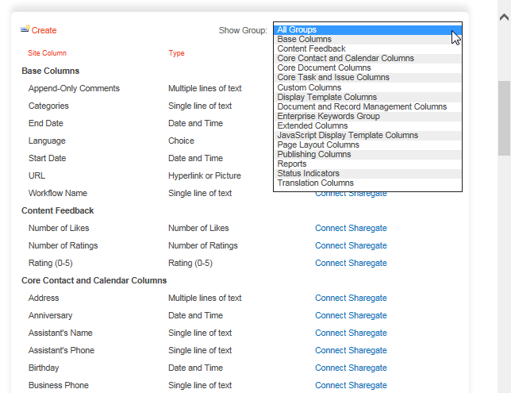
About Site Columns
Site columns can be re-used in a site’s lists, libraries and subsites
There is an extensive list of existing site columns in ~15 groups
NCDOT-specific site columns are usually in the Custom Columns group

Slide 42
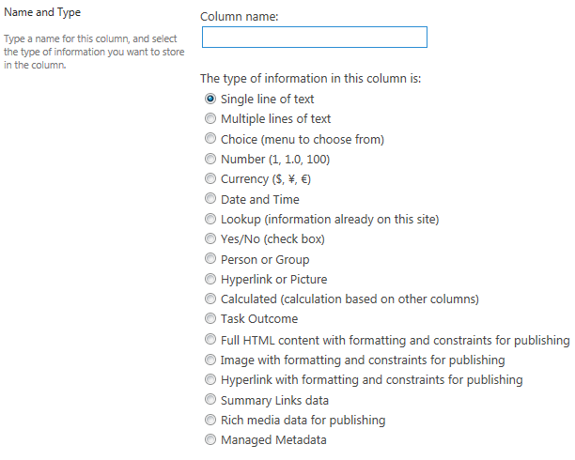
Site Column Types
A site column can be any of the column types covered earlier – or it can be one of five additional types

Slide 43
Let’s Learn How to …
Add a site column

Slide 44
Add a Site Column
LIST or LIBRARY tab > List or Library Settings > Add from existing site columns
Select site column > Add
Complete additional settings > OK

Slide 45
Plan Your Columns
Plan columns and metadata carefully so you will have more flexibility for sorting, grouping and filtering
For example, if people need to see only documents that apply to their division, you’ll need a column for division
Display the most useful information in the view so users don’t have to open items or files.

Slide 46
When Do List or Library Changes Go Live?
Inside
Immediately
Connect team/project sites
Immediately
Unauthenticated (public) area of Connect
Make changes on a staging server; changes are copied to a production server at :42 after the hour
There may be review or approval processes in your area

Slide 47
Exercise 3: Columns
Go to the Designer Class home page
Click Exercises for the links you’ll need

